Slide 1
A Project On Departmental Store Management Syatem

Slide 2
Objectives and Scope
The main objectives of our projects are listed as follows:
To develop a Database management
system (DBMS) which manages the
data of a department store.

Slide 3
To develop a billing system for points of sales (POS) in System so as to record and updates stocks as well as transactions.

Slide 4
To develop an Inventory Management System so as to record and updates stocks as well as transactions.

Slide 5
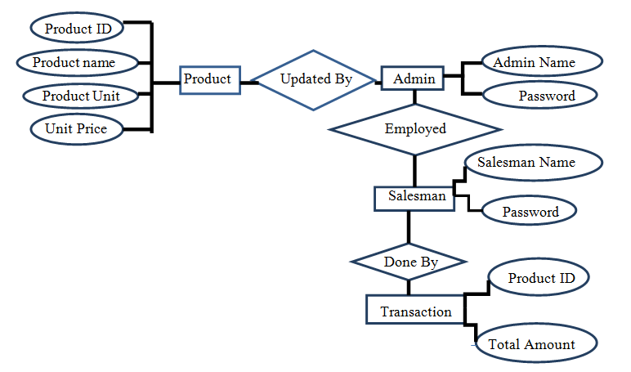
System Diagram……

Slide 6
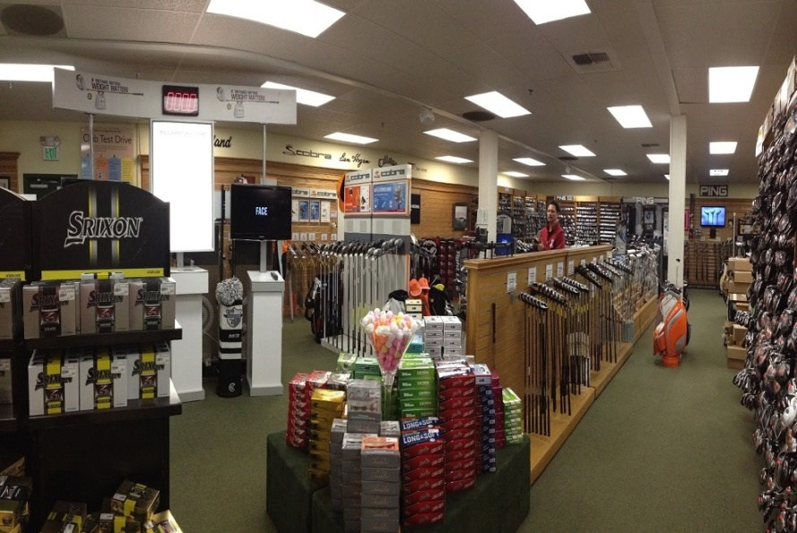
The Department Store Management System is divided into following parts: 1. Database 2. Inventory Management System 3. Billing System

Slide 7
Database
stores the inventory records
includes product information such as product ID, name, unit etc

Slide 8
maintains the record of admins and their login password as well as the salesman’s

Slide 9
Inventory Management System
system includes tools for entering and updating the records in the inventory
automatically updates the inventory after the sale of any product

Slide 10
Billing System
creates and prints the invoice after product entry at the Point of Sale(POS) by the salesman
date, price of the specific product, total cost will be automatically generated and calculated

Slide 11
the invoice will be noted in a PDF file which can be printed

Slide 12
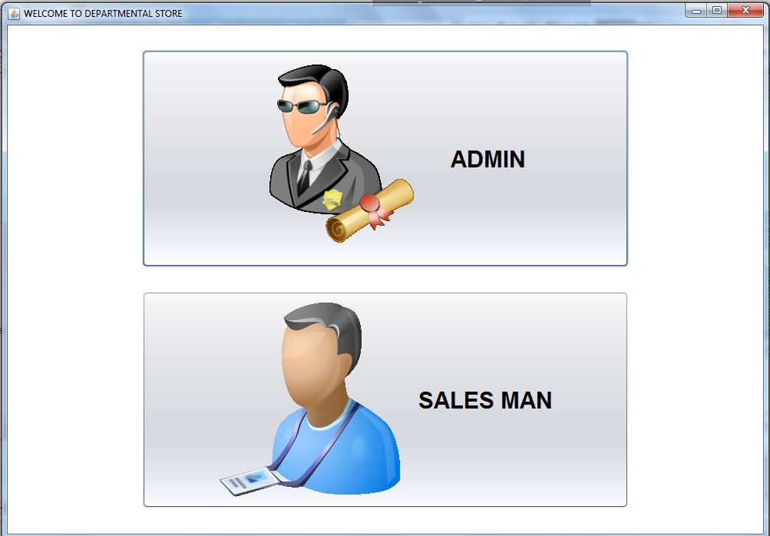
Entrance Window

Slide 13
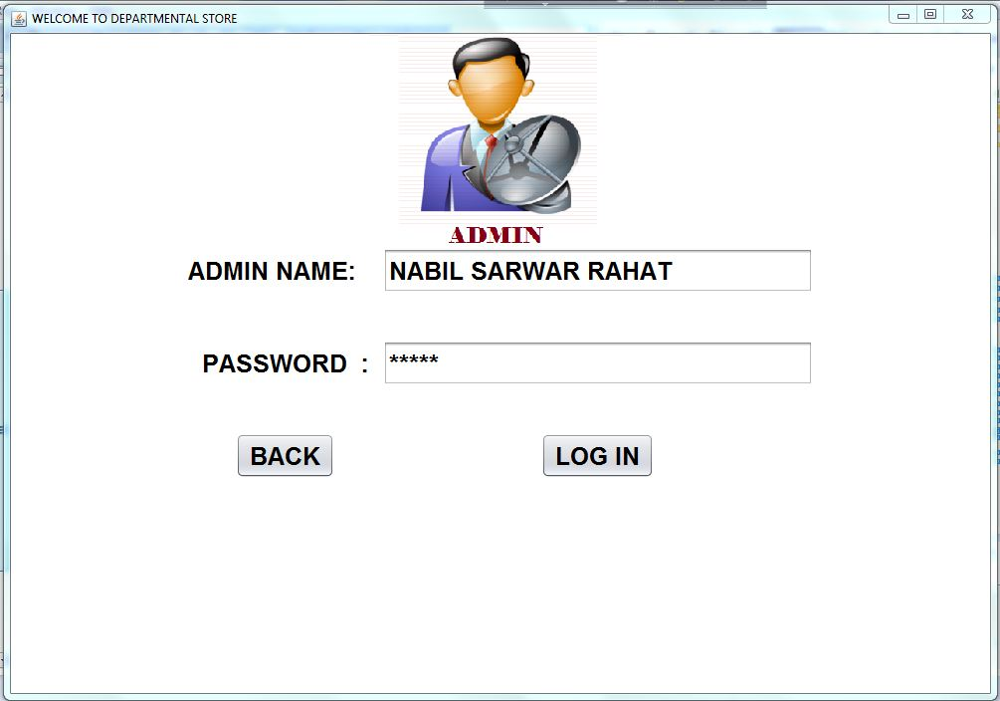
Admin Entrance

Slide 14
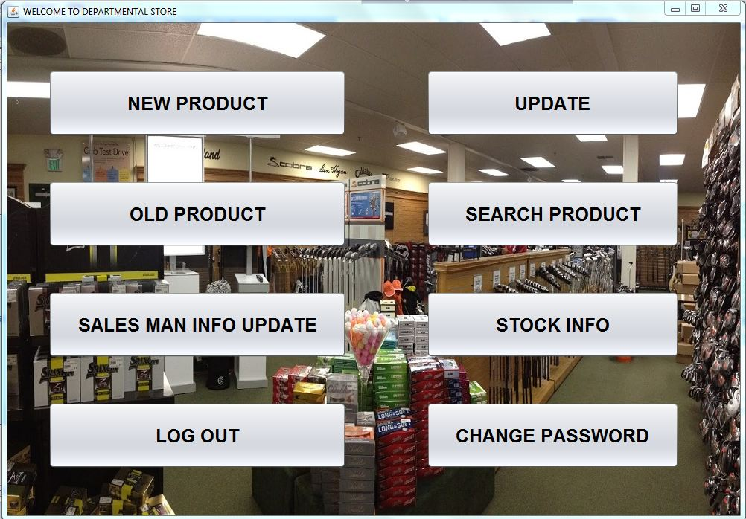
Admin Panel

Slide 15
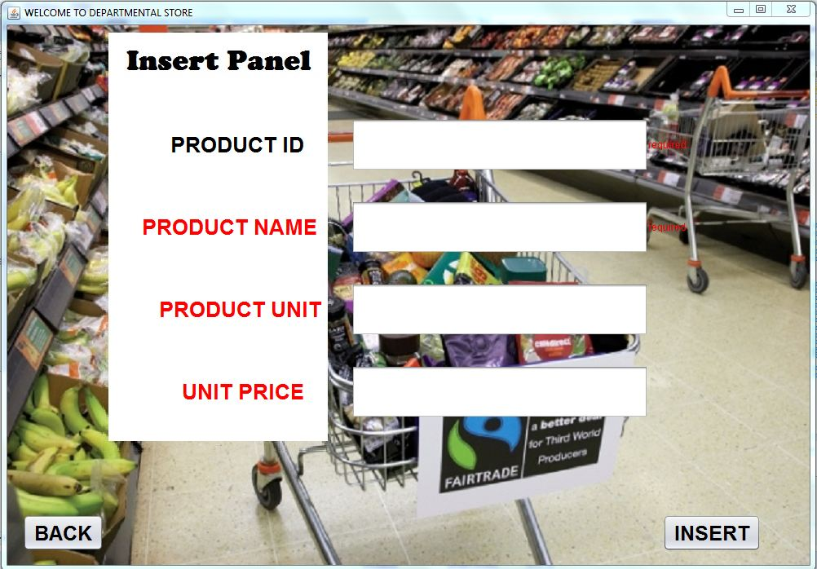
Insert Panel

Slide 16
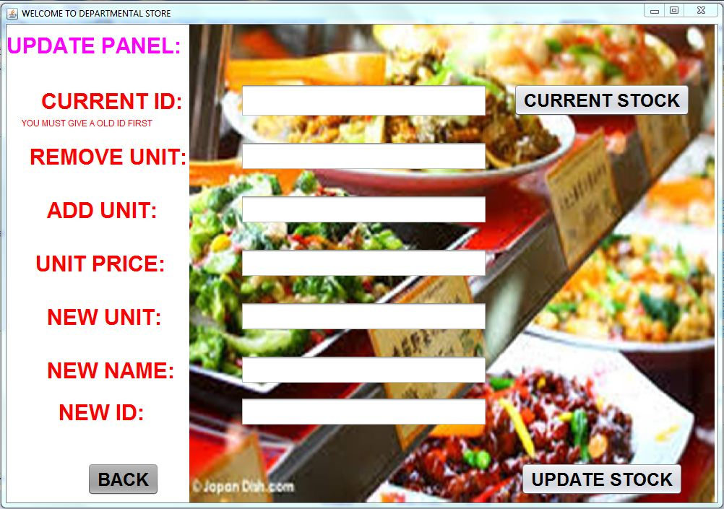
Update Panel

Slide 17
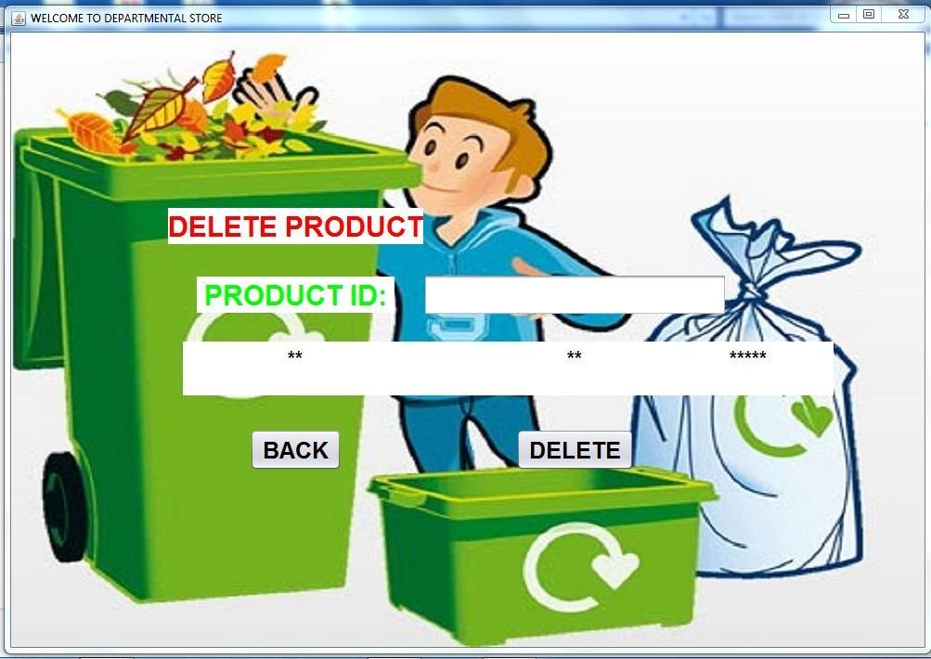
Delete Product

Slide 18
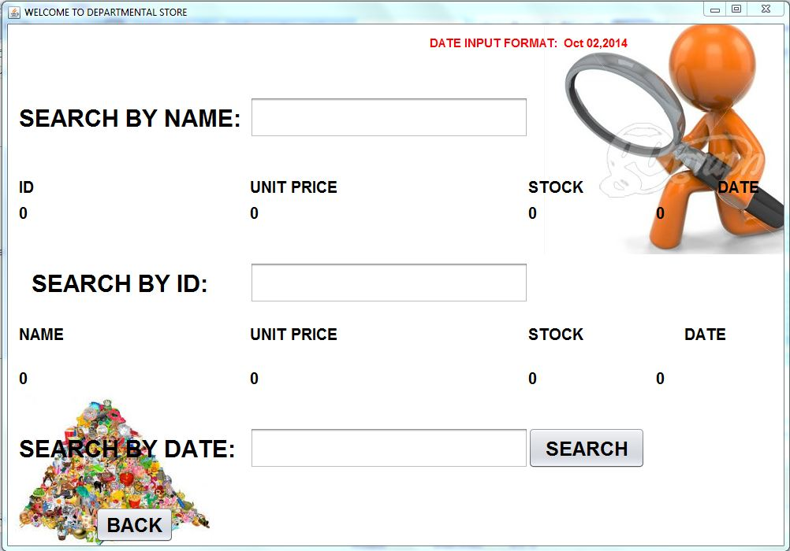
Search Product

Slide 19
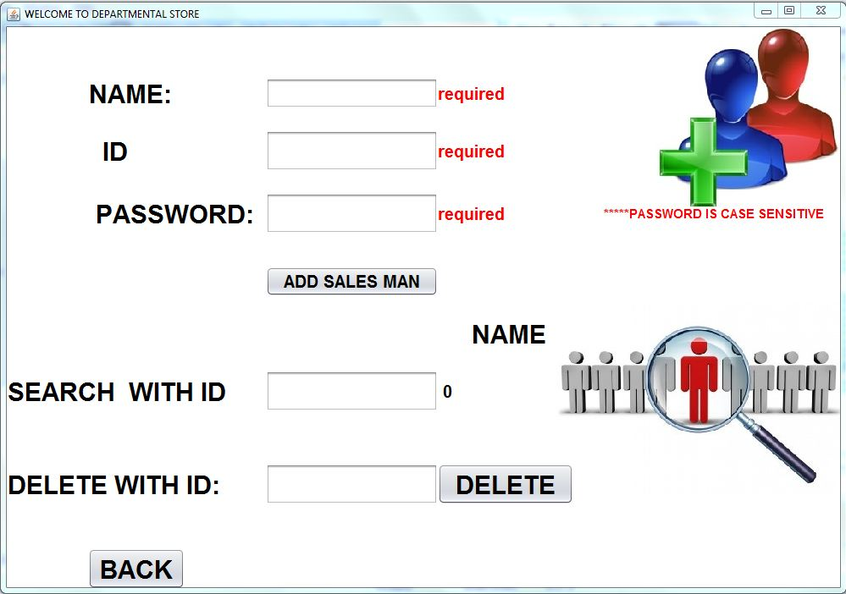
Salesman Info

Slide 20
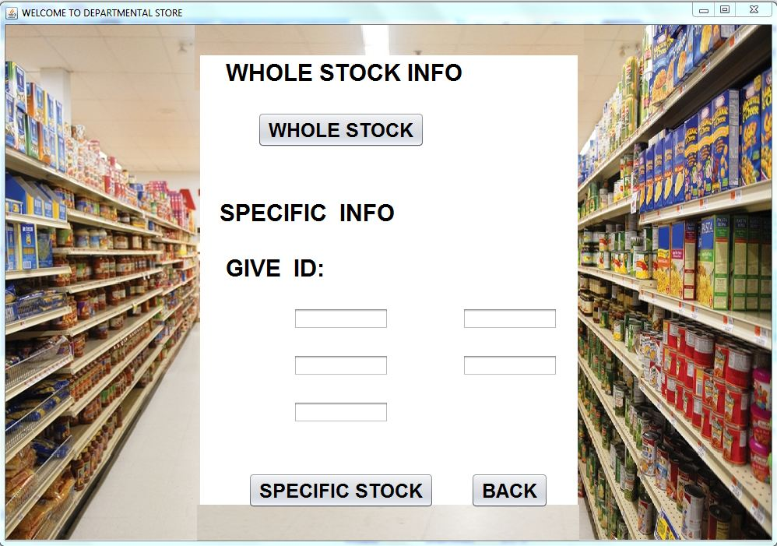
Whole Stock Info

Slide 21
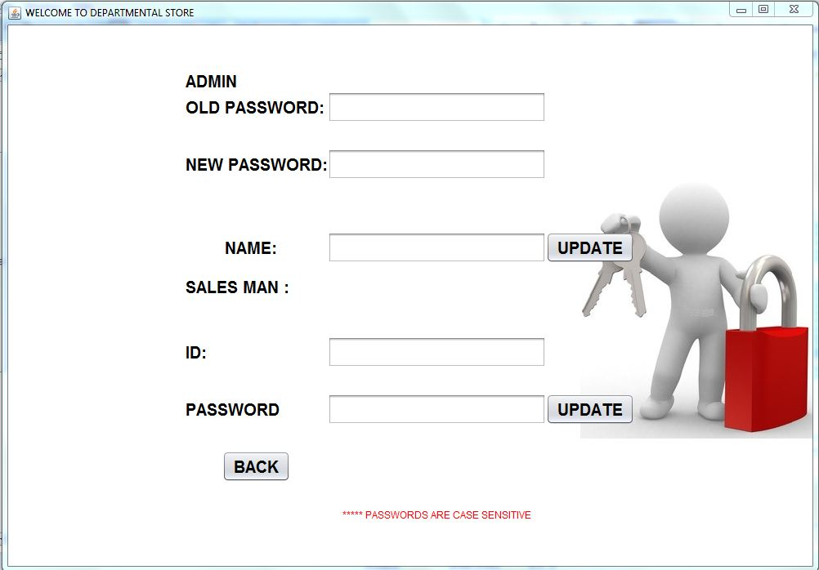
Change Password

Slide 22
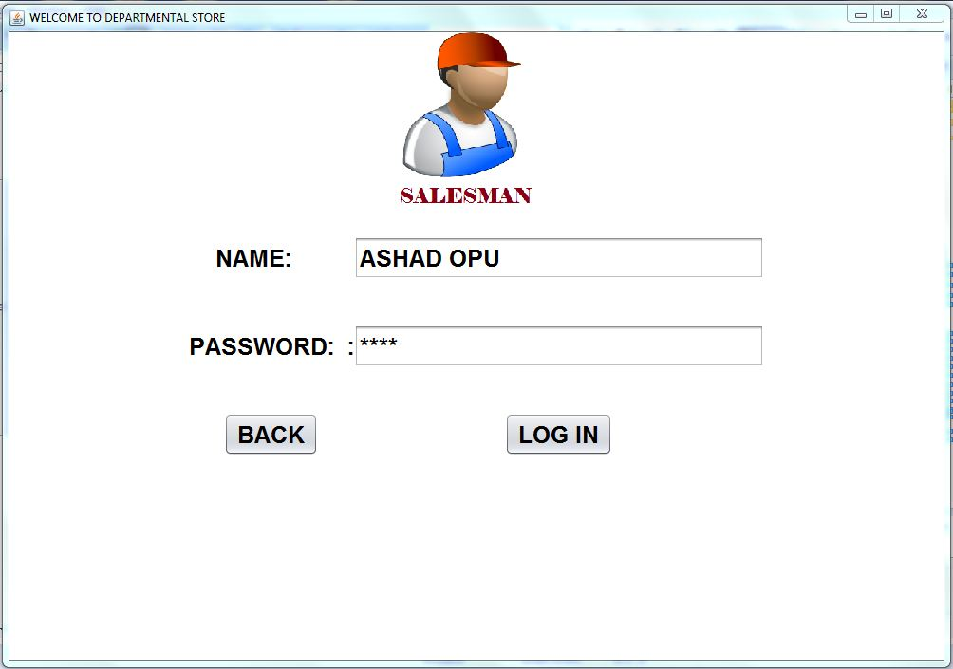
Salesman Entrance

Slide 23
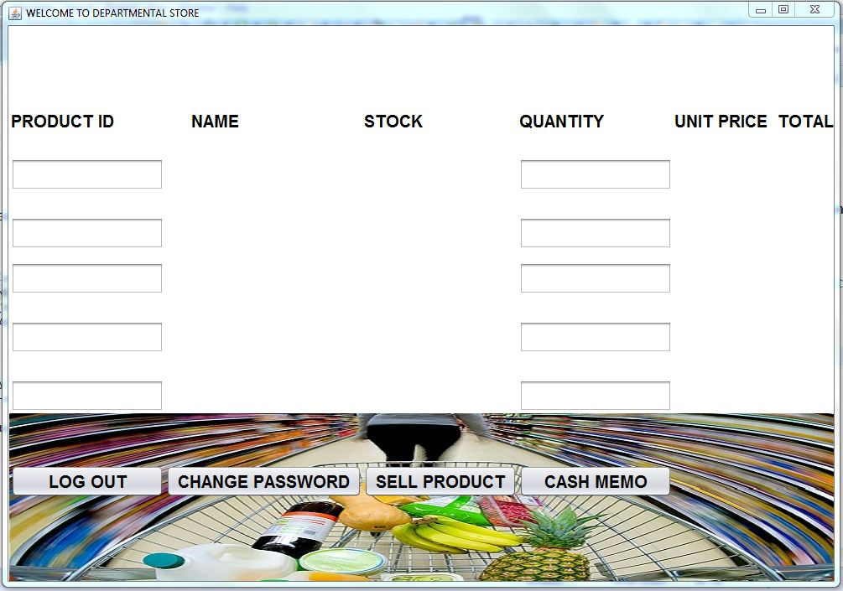
Salesman’s Workplace

Slide 24
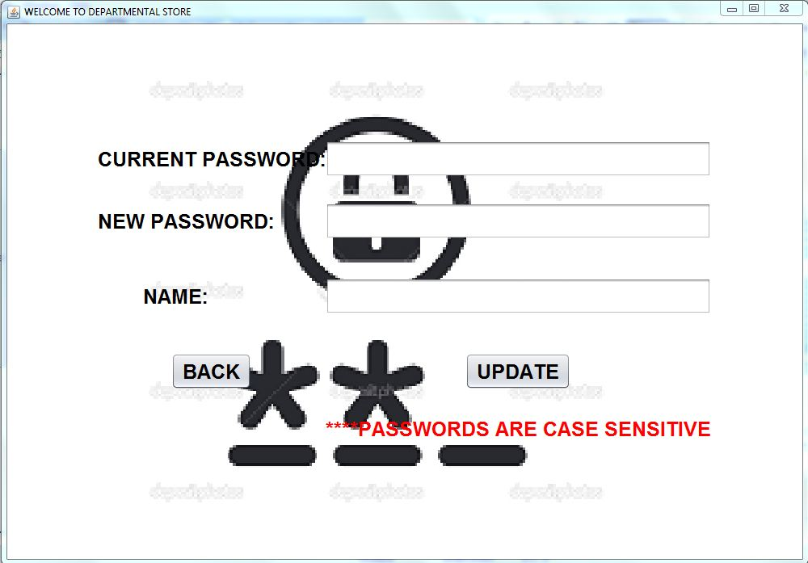
Change Password

Slide 25
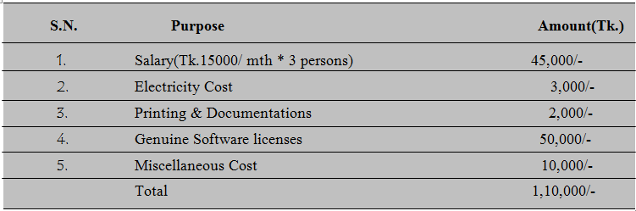
Cost Estimation

Slide 26
Future Plan
add many other features like MIS
Android Version

Slide 27


